Slide 1
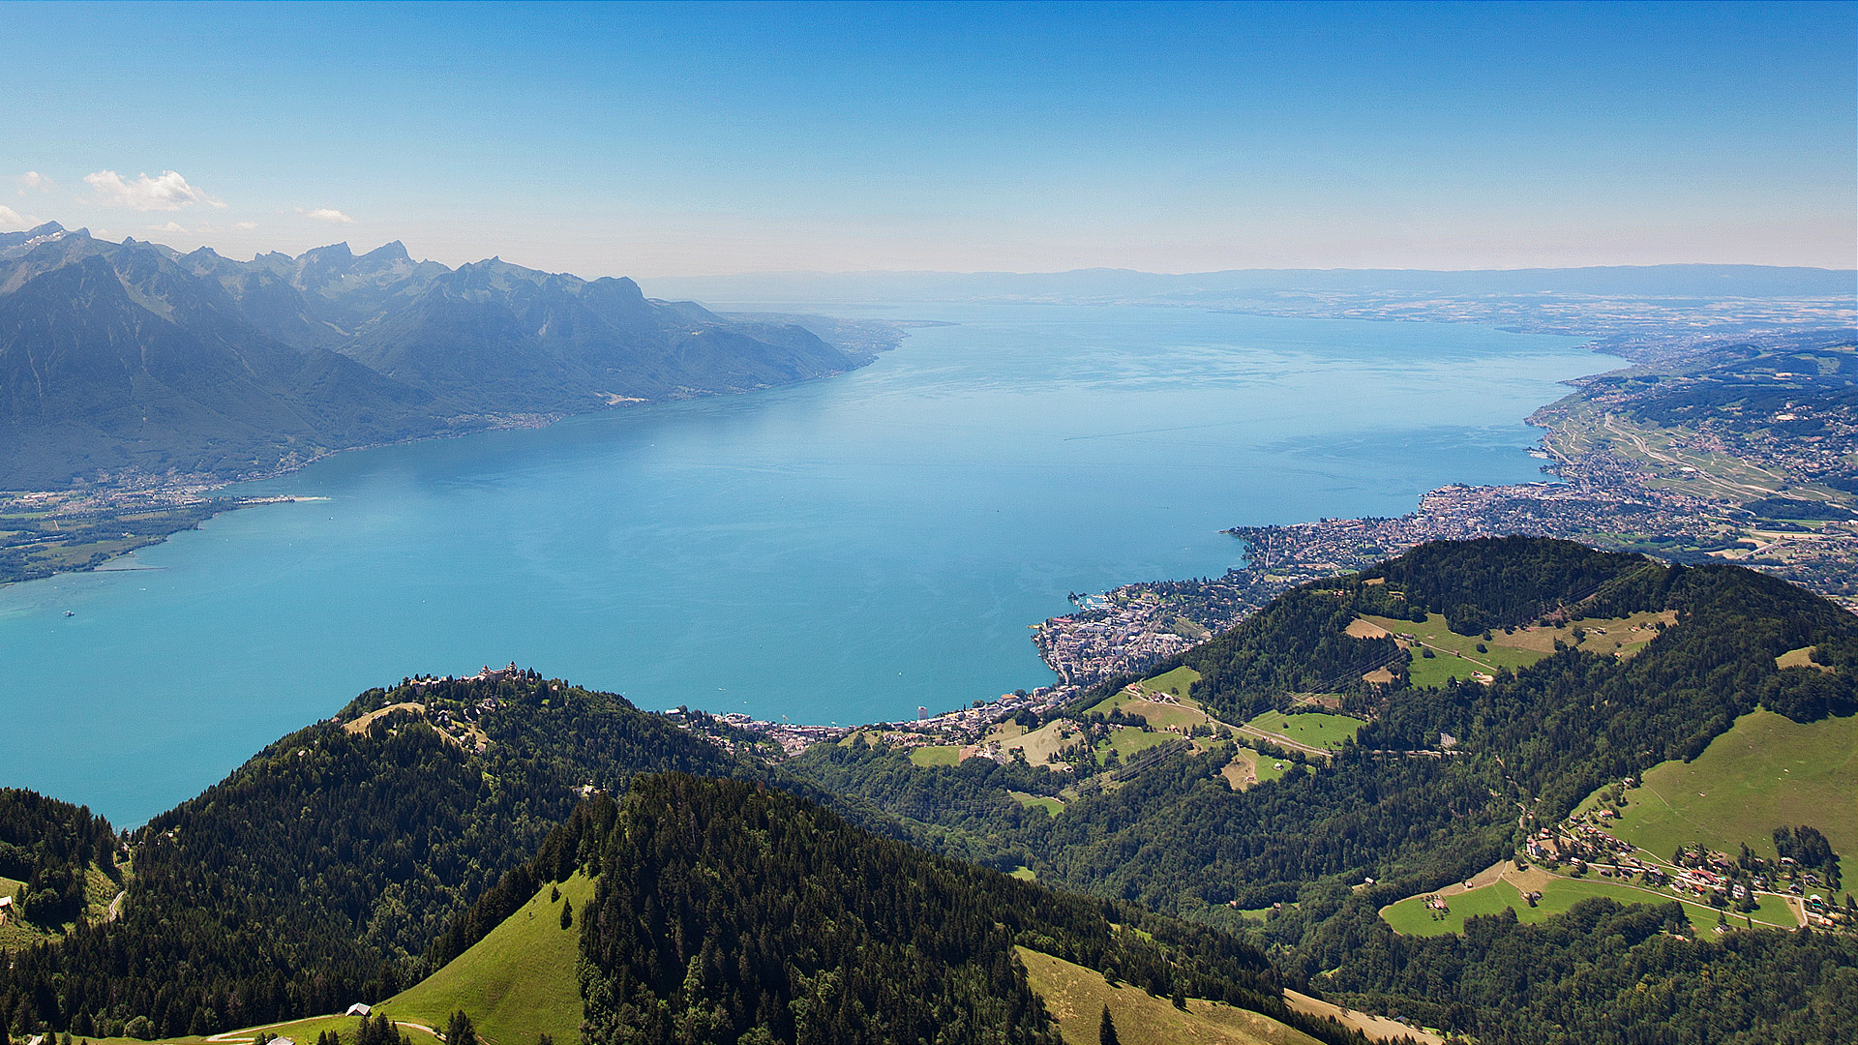

PC-MIP Pollen-Climate Model Inter-comparison Project Workshop
13-15th June 2017, Caux, Switzerland
PC-MIP-1 was here

Slide 2
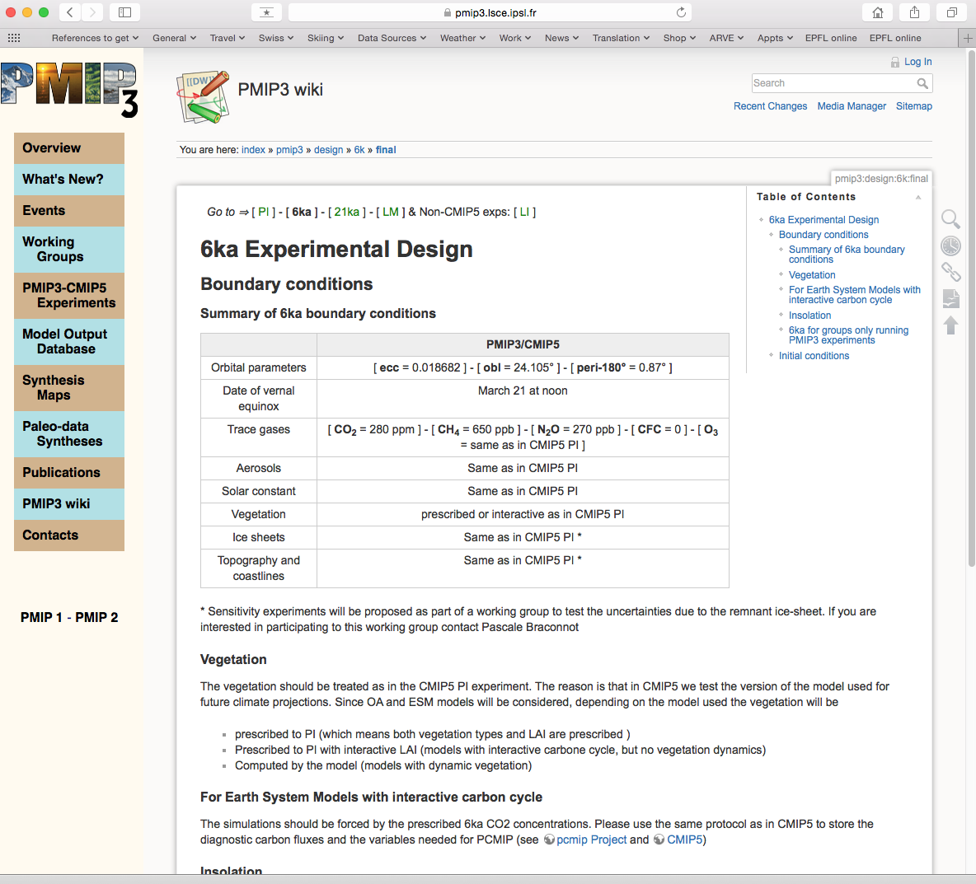
PC-MIP idea stolen from the Palaeo-(Climate) Model Intercomparison Project (PMIP)
Standard set of boundary conditions

Slide 3



Workshop Funding
44% SNF International Workshop Grant
17% PAGES
7% INQUA
33% SNF via HORNET Project

Slide 4
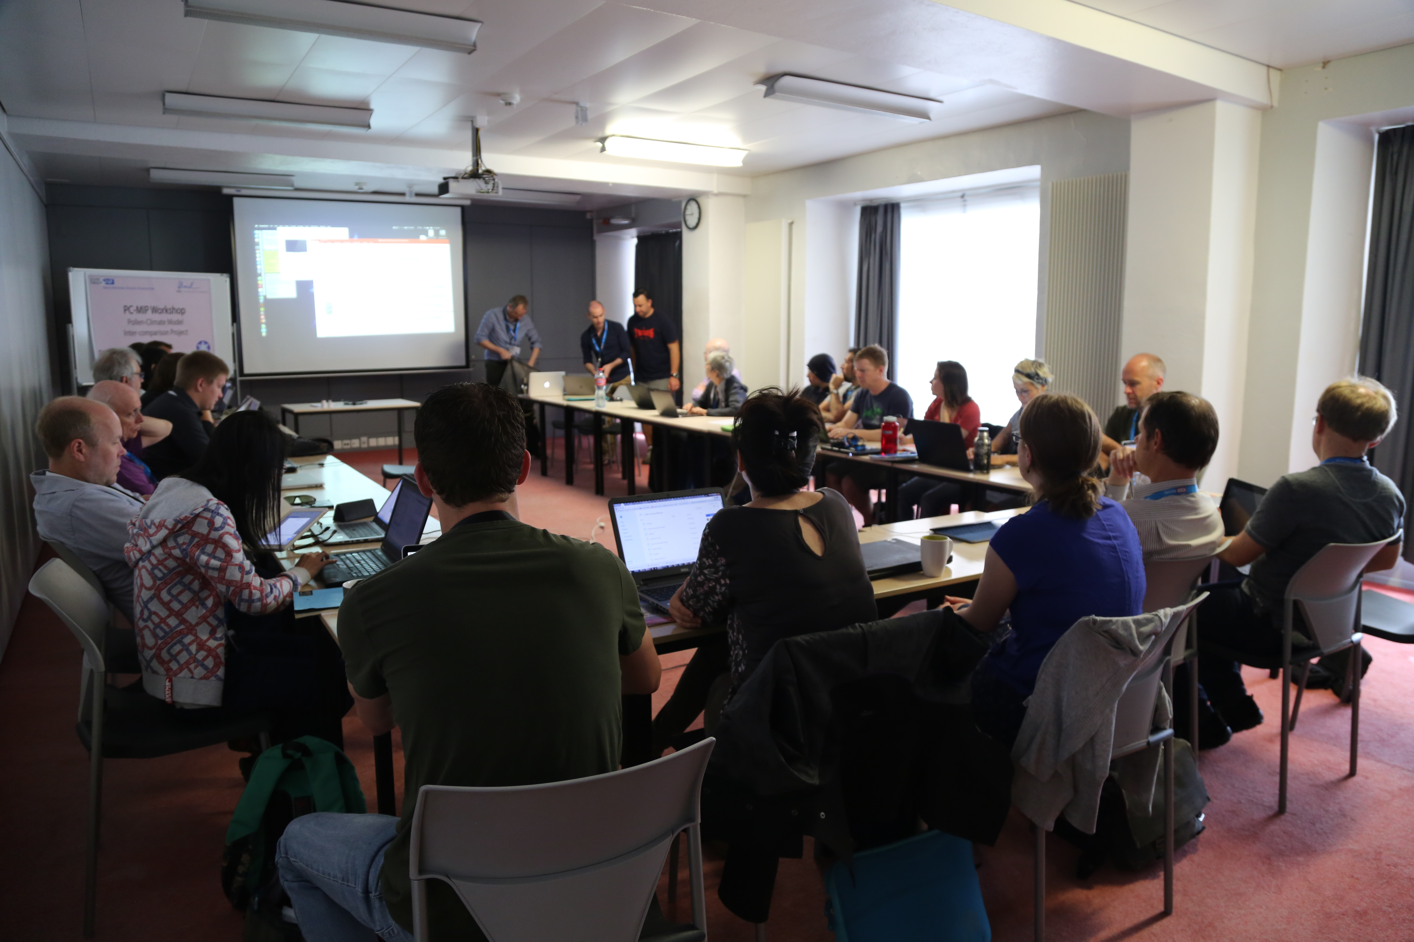
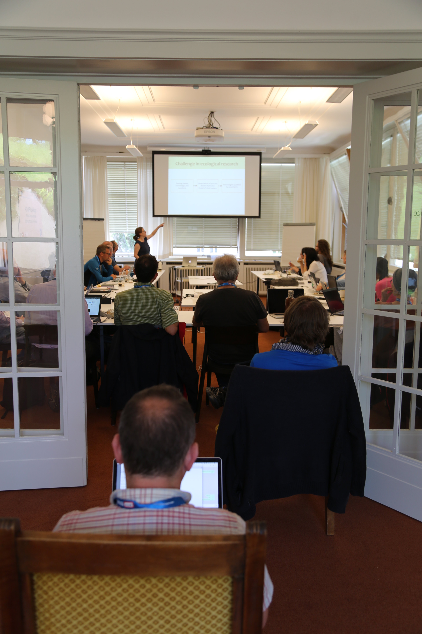
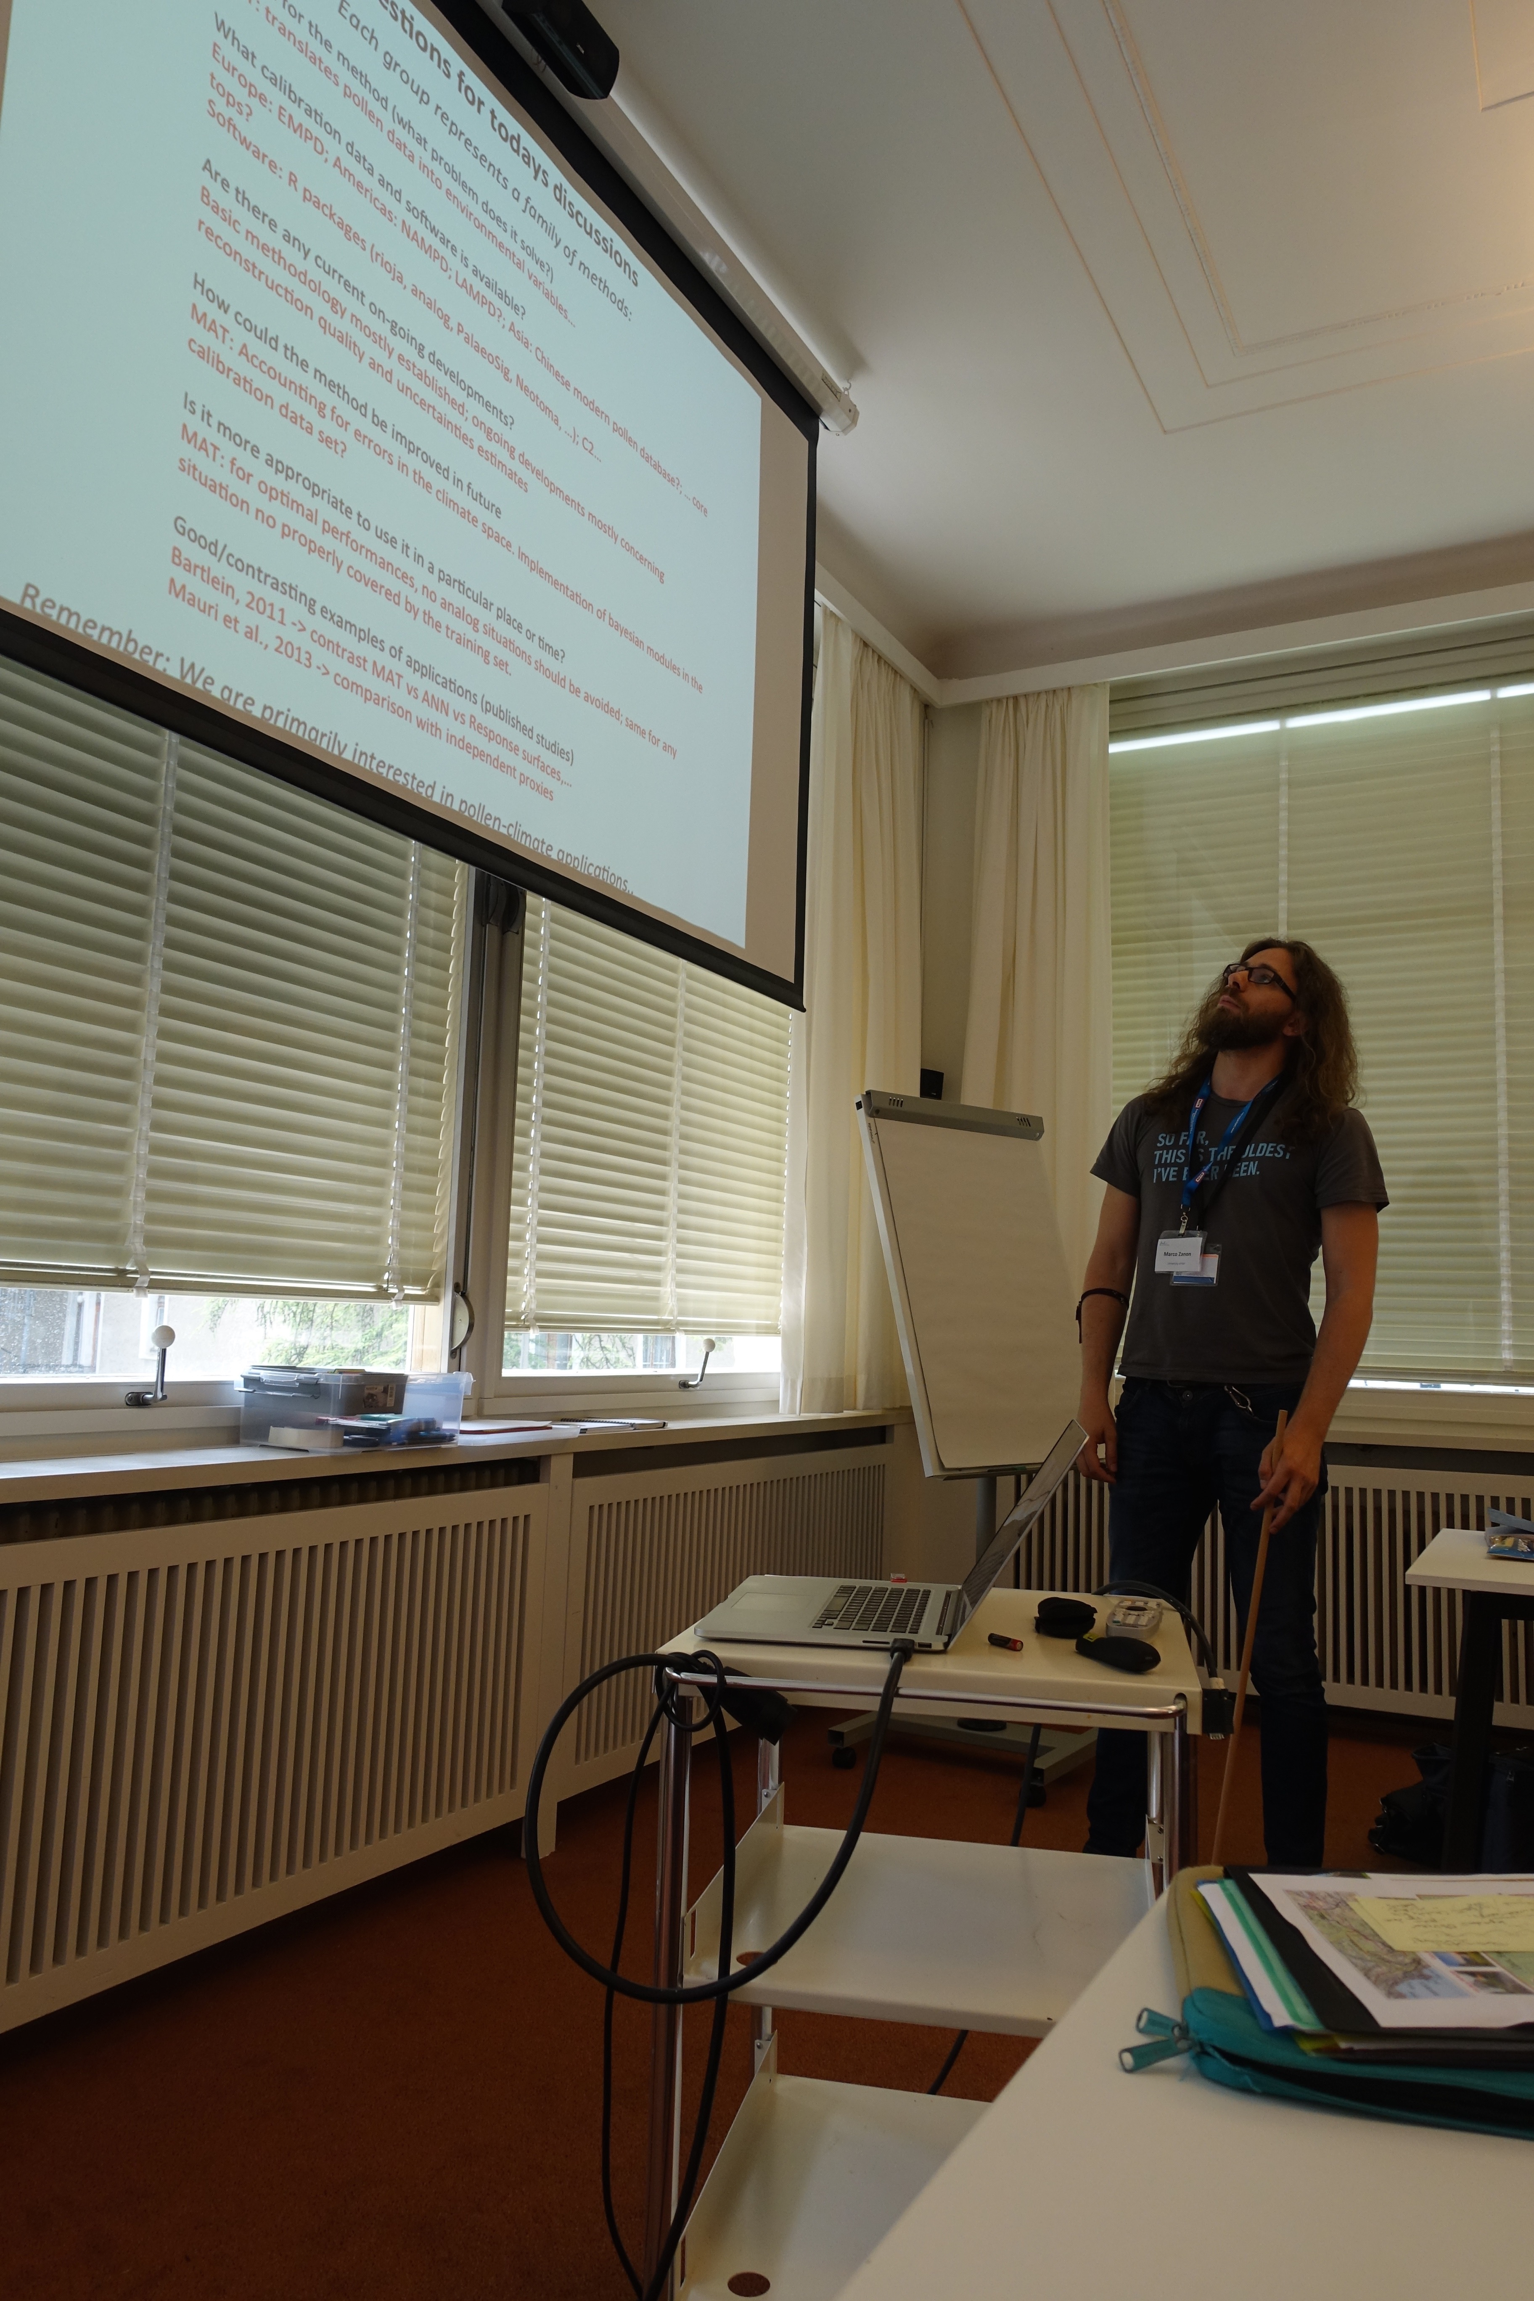
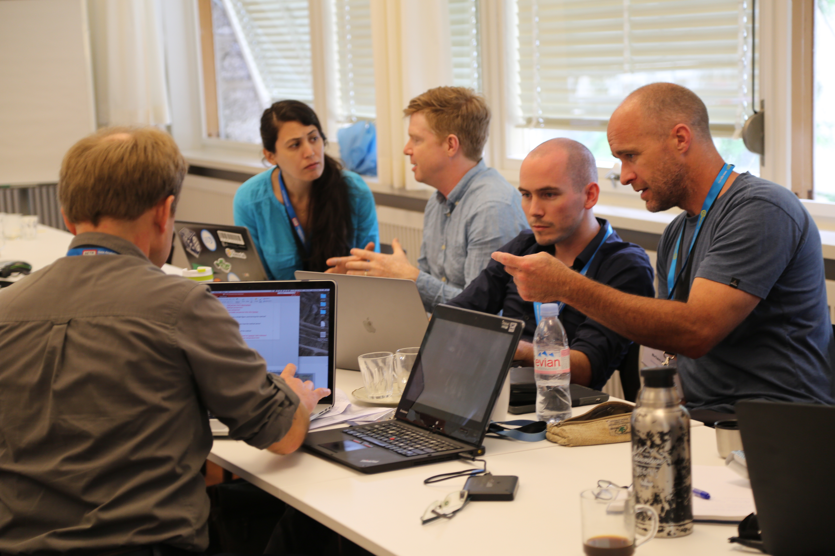

Slide 5
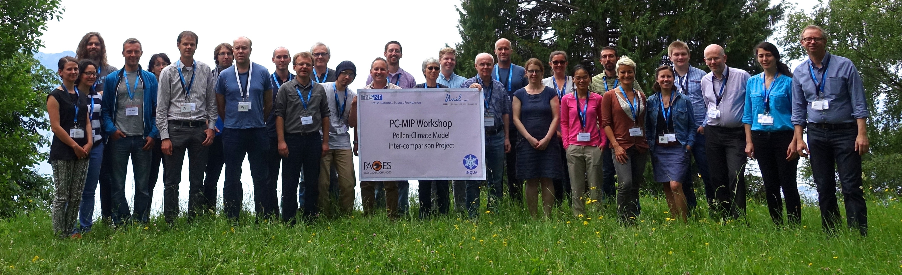

Slide 6
Manu
Simon
Andria
Basil

Slide 7
Manu
Simon
Andria
Basil

Slide 8
Workshop Motivation

Slide 9
Motivation: Data-model discrepancies
Mid-Holocene
6000 BP
Summer
Increasing model complexity
Summer temperature anomaly
Figure from: PMIP website: https://pmip3.lsce.ipsl.fr

Slide 10
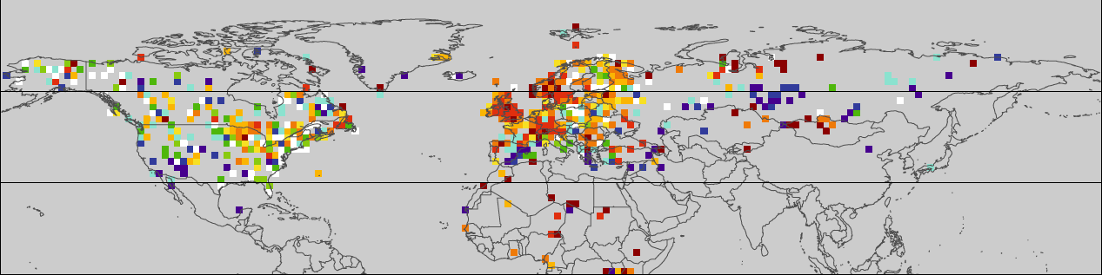
Motivation: Data-model discrepancies
Mid-Holocene
6000 BP
Summer
Data
Bartlein et al. 2011
Increasing model complexity
Summer temperature anomaly
Data from: Bartlein et al. 2011 Pollen-based continental climate reconstructions at 6 and 21 ka: a global synthesis.

Slide 11
Motivation: Data-model discrepancies
Mid-Holocene
6000 BP
Summer
Data
Bartlein et al. 2011
Uniform warming
Increasing model complexity
Uniform warming
Uniform warming
Summer temperature anomaly

Slide 12
Motivation: Data-model discrepancies
Mid-Holocene
6000 BP
Summer
Data
Bartlein et al. 2011
Insolation
Increasing model complexity
Insolation
Insolation
Summer temperature anomaly

Slide 13
Motivation: Data-model discrepancies
Mid-Holocene
6000 BP
Summer
Data
Bartlein et al. 2011
Increasing model complexity
Summer temperature anomaly

Slide 14
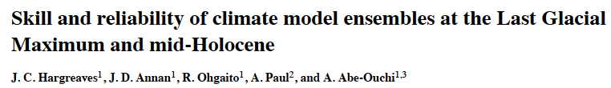
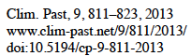
PMIP3/CMIP5 data-model comparison
“..our results for the mid-Holocene are substantially negative, with the models failing to reproduce the observed changes with any degree of skill.”
Climate models and pollen-based climate reconstructions show big differences
for the mid-Holocene; is it the models or the data?

Slide 15
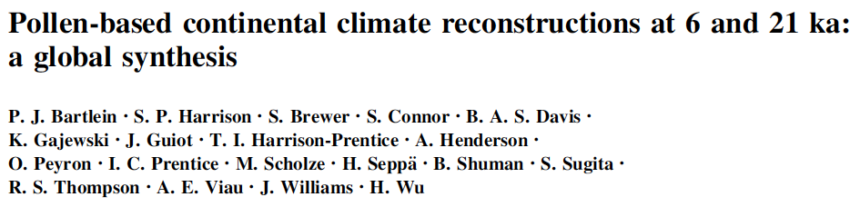
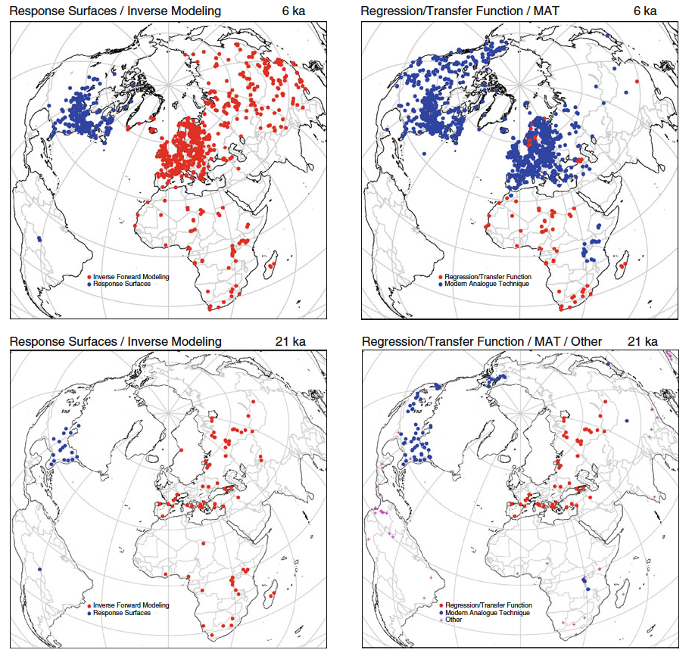
Bartlein et al. 2013 data synthesis
Combines data from many different studies published over the last ~30 years
1. Different reconstruction methods
2. Different ‘flavours’ of the same method
3. Different approaches to uncertainty
4. Different calibration datasets
5. Different climate variables

Slide 16
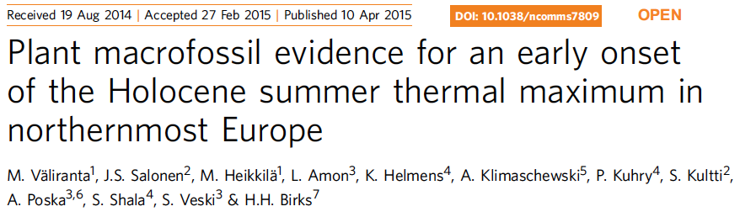
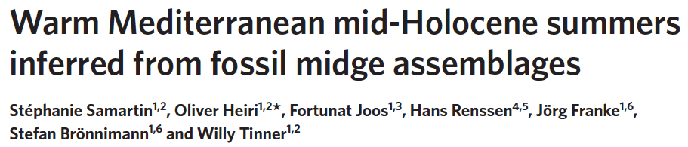

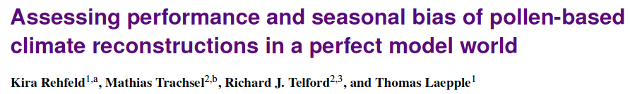
Motivation: Recent criticism of pollen-based reconstructions
Aquatic macrofossils show early Holocene warming, pollen does not.
Criticism: migration lag
Chironomids show early-mid Holocene summer warming, pollen does not.
Criticism: human impact and precipitation are the dominant controls on vegetation, not summer temperatures
Synthetic pollen samples show how reconstructions may be biased under novel climates in the past
Criticism: co-variance of climate variables

Slide 17
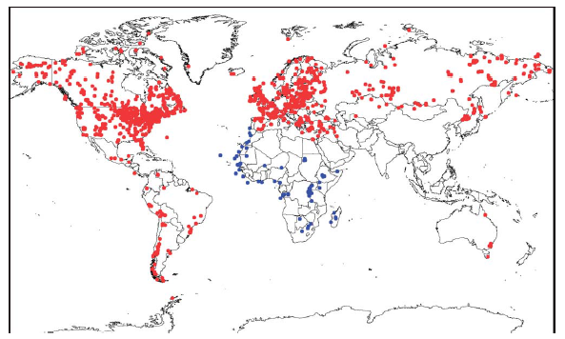
Increasing fossil pollen data availability
NEOTOMA.org
North American Pollen Database
European
Pollen Database
Chinese
Pollen Database
Latin American Pollen Database
Indo-Pacific
Pollen Database
African
Pollen Database
Other data sources: PANGAEA, NOAA Paleoclimate, Private databases/datasets

Slide 18
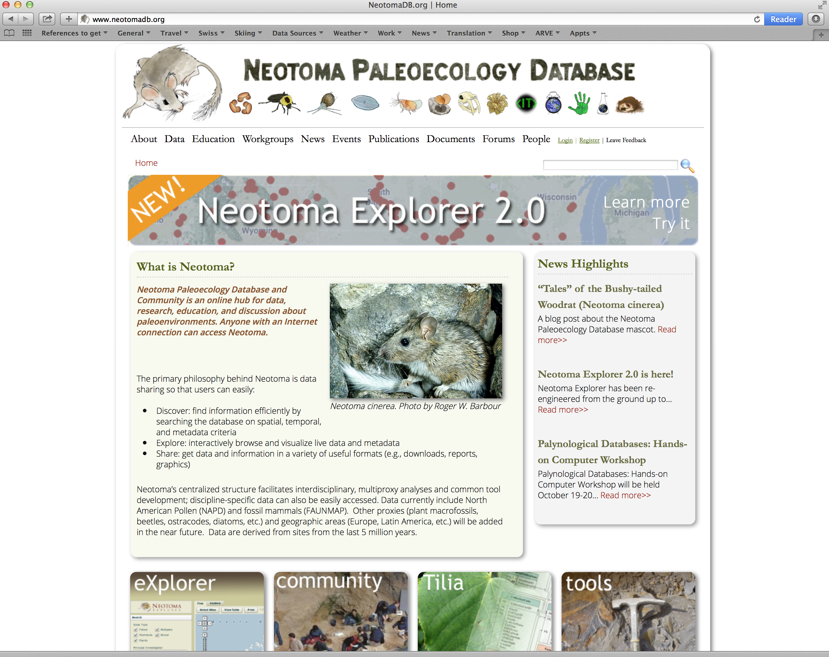
Ask Simon Goring..

Slide 19
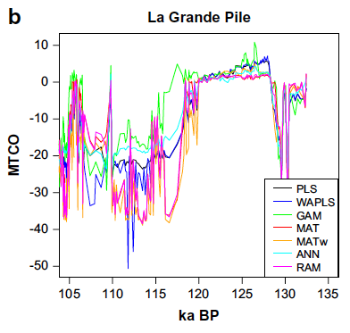
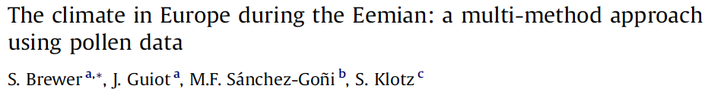
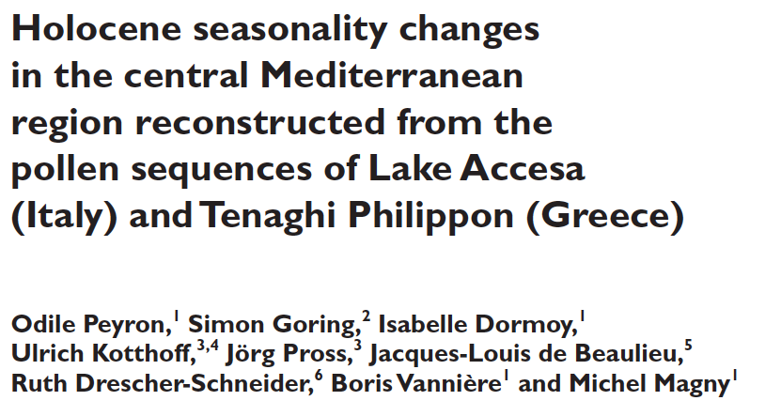
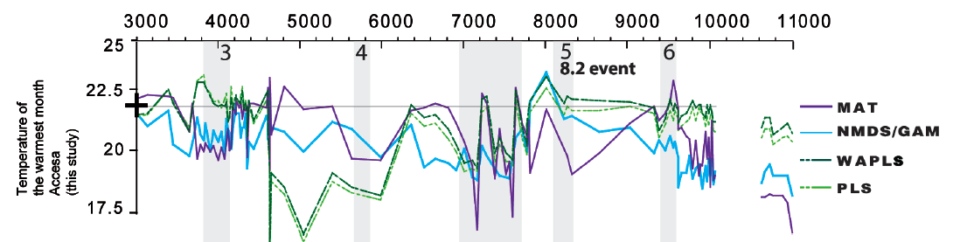
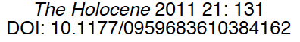
Recent developments
Multi-method reconstructions

Slide 20
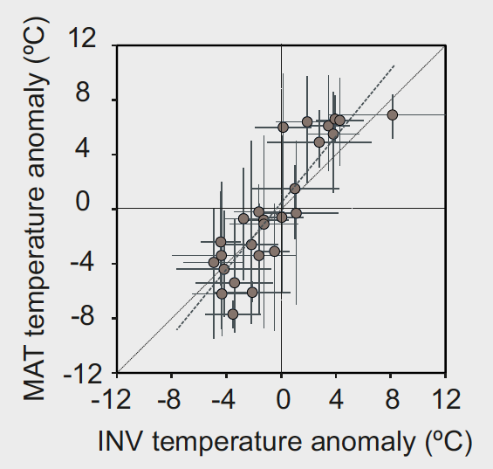
Recent developments
Multi-method comparisons
Summer Temperature
Southern Europe
6000 BP
Comparison of pollen-based reconstructions of summer temperature over Southern Europe at 6000 BP using MAT (modern analogue technique, Davis et al. 2003) and INV (inverse modelling, Wu et al. 2007). Analysis shows good agreement between the two methods, with little evidence of the hypothesised bias in MAT.

Slide 21
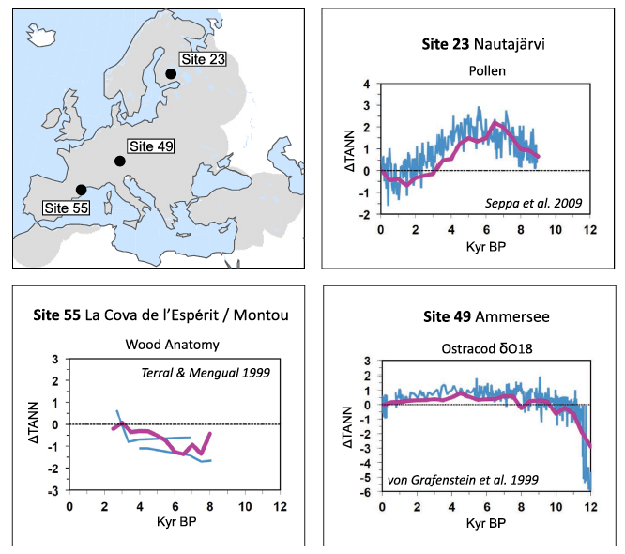
Recent developments
Multi-proxy comparisons
Mauri et al. (2015) The climate of Europe during the Holocene: a gridded pollen-based reconstruction and its multi-proxy evaluation

Slide 22
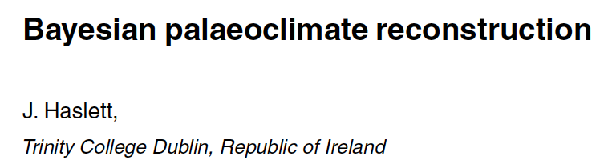
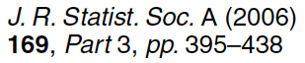
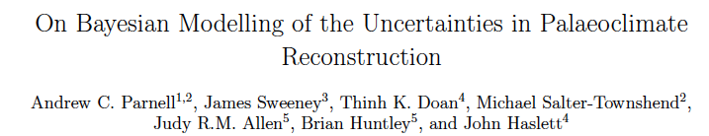
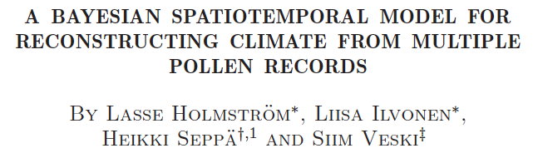
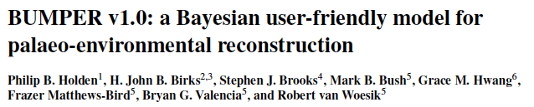
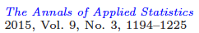
Recent developments
Bayesian frameworks

Slide 23
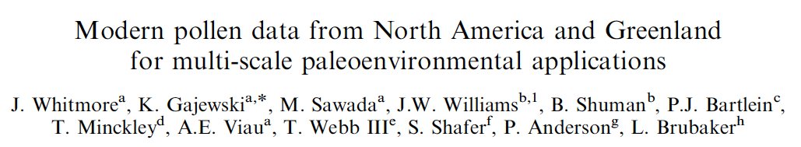

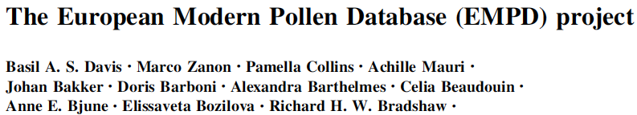
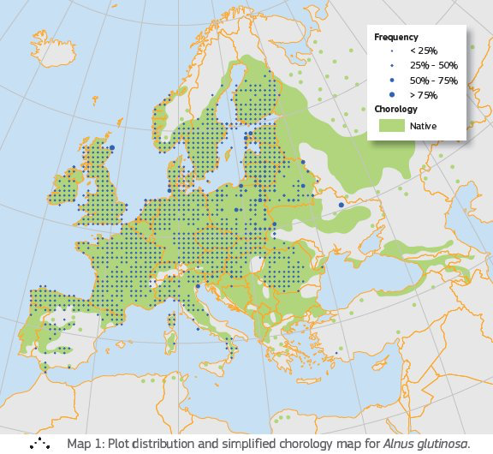
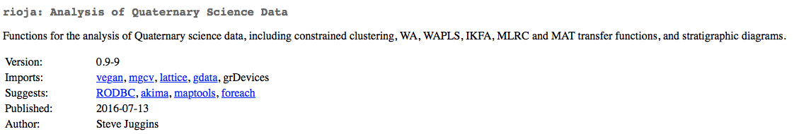
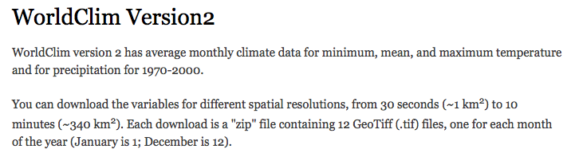
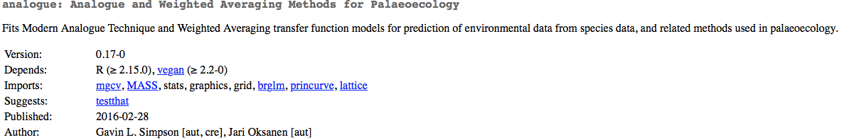
Tools of the trade
Modern pollen training sets
Modern vegetation mapping
http://forest.jrc.ec.europa.eu/european-atlas-of-forest-tree-species/
Software
Modern climatology
‘rioja’ R Package
‘Analogue’ R Package
http://worldclim.org/version2

Slide 24
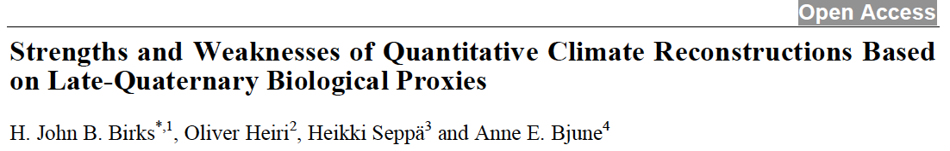
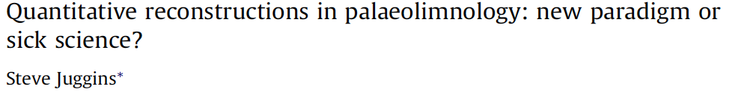
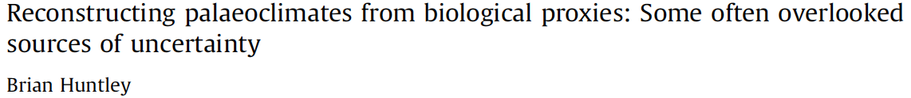
State of the art
Existing reviews of pollen-climate reconstruction methods

Slide 25
Workshop Details

Slide 26
Workshop Objectives
Direct outputs
1. ‘State of the art’ Review paper/Information resource
Opportunity for co-authorship (Manuel Chevalier coordinator)
There will be a role for everyone even non-experts
2. Bench test: Comparison of different methods using same datasets
Discussion on Thursday morning. This is now a future project. Volunteers needed, but will require active participation and another workshop.
Indirect outputs: Bringing together the pollen-climate community
Focus of the workshop: Reconstructing climate from pollen data

Slide 27
Workshop objective 1: Review paper/Information resource
Added value? What is different from what has gone before?
1. Community based approach; more ‘balanced’ perspective
2. Inclusive; all methods represented equally
3. State of the art; including problems and solutions (upto date)
4. Information & resources; literature, data & databases, software
5. Recommendations for best practice?; when and why to apply the method?
6. Evaluation?; strategies for evaluation
7. Future directions/strategies

Slide 28
Discussion points, Day 1
1. Which climate variables can be reconstructed?
2. The no-analogue vegetation problem
3. The no-analogue climate problem
4. Modern climate data
5. Modern pollen data/training sets
6. Multi-model approaches
7. Multi-proxy approaches
8. The spatial auto-correlation problem
9. Long-distance pollen transport
10. Uniformitarianism
11. Taphonomic, laboratory and sampling errors
12. Any other issues??
We are looking for problems, solutions, examples, publications
Add and answer your own questions!

Slide 29
Discussion points, Day 2
Each breakout group group represents a family of methods:
Priority
Questions
What different method varieties are there (pollen-climate)?
What are the strengths of the method?
What are the weaknesses of the method?
Reason for the method (what problem does it solve?)
What calibration data and software is available?
Are there any current on-going developments?
How could the method be improved in future?
Is it more appropriate to use it in a particular place or time?
Good/contrasting examples of applications (published studies)
Can you draw a simple figure summarizing the method?
Can you describe simply how the method works?
Brief scientific history of the method
Any other questions/answers?
Remember: We are primarily interested in pollen-climate applications..

Slide 31
PC-MIP/Bench Test

Slide 32

PC-MIP/Bench Test
Aims:
To be able to compare all current methods using standardised datasets/metrics
To make it easy for future methods to be compared with old (using the same standardised datasets/metrics)
How?
Choose illustrative time-series (ie sites) and time-slices (‘maps’)
Use standardised modern calibration data (eg modern surface samples)
What might be ‘illustrative’?
Holocene (good analogues, human impacts, disease)
Late Glacial (poor analogues, migration lag)
Full Glacial (low CO2 problem)
Eemian, MIS 11 (poor analogues?)

Slide 33
PC-MIP/Bench Test
Issues:
1. Need to recognise some methods are designed to work better in the past, not the present. Evaluation using modern data is not always useful or desirable.
2. Useful to choose datasets where we can compare with other proxies? eg isotopes, chironomids, macros, geomorphology etc
3. Some methods technically difficult to apply (eg PDF, Inverse Modelling). If we cant find someone to do this on new datasets, should we use existing studies?
4. Artificial data. One approach might be to use artificial pollen data to test the response of the different methods to a specific problem; eg deterioration in analogues, human impact (eg deforestation), fire etc

Slide 34
PC-MIP/Bench Test
New ideas?:
1. Which method is the best under which circumstances? Can we develop a multi-method-method that is the best of all worlds?
2. Can we set quality control standards? What is the minimum size or diversity for a modern pollen calibration data set? (China paper)
3. At present we mostly treat samples separately from each other. What about multi-sample/site approaches eg Bayesian; we have a lot of noise in our data, but also a lot of data

